Slide 1
Tax

Slide 2
Meaning of Tax
In general, tax can be defined as a levy or other type of financial charge or fee imposed by state or central government on legal entities or individuals. It is a compulsory levy form individuals, households, and firms to central or local government. It is a kind of money of which it is levied on income, property and even at the time of purchasing a commodity. Tax is computed and paid as prescribed in the law. If a person defies the tax payment; he or she may be punished in the court of law.
In other words, tax is as compulsory contribution or payment to government by the people and institution without any expectation of direct benefit. Hence, tax payer does not get any definite and direct benefit against the payment of tax. Tax is a major part of public revenue sources. It is neither as borrowing/ loan nor a grant. Similarly, it is not any fee or fine or price undertaken by the government. They are imposed upon all those people who are able to pay or earn, who owns property, who does consume or expense.

Slide 3
Some future of tax
Tax is a compulsory payment
People do not receive direct benefit from tax
The fund raised form tax is spent on public welfare.

Slide 4
Structure of tax
On the basis of nature and impact, tax is divided into two types
Direct tax
Indirect tax
A direct tax is a form of tax paid by a person on whom it is legally imposed. It is collected directly by the government from the person who bears the tax burden. Taxpayers need to file tax returns directly to government. Therefore, direct tax cannot be shifted. The impact or the money burden and the incidence are on the one and the same person. In other words, the same person pays and bears the tax burden. It is the tax on income, and property. Examples include income tax, property tax, vehicle tax, interest tax, expenditure tax, death tax, gift tax etc.

Slide 5
Indirect tax
An indirect tax is a form of tax imposed on one person but partly or wholly paid by another. It is collected by mediators who transfer he taxes to the government and also perform functions associated with filing taxes return. Hence, indirect tax can be shifted. In indirect tax, the impact and incidence of tax are on different person. In other words, the person paying and bearing the tax is different. It is the tax on consumption or expenditures. Examples include VAT, excise duty, import and export duty etc.

Slide 6
Taxation in Nepal
Nepal has a long history in the taxation. Land tax has been found to be practiced form Lichhavi period and excise duty was imposed on Rana regime. Up to the Rana regime, tax system was governed by various Sanad Sawal. (Laws) developed for specific areas were not institutionalized in that time and method of collection too was not systematic. For example, custom duties were collected through contractors; land revenues were collected by Mukhiya, Zimwal or Zamindar in different parts of country and there were authorized by the power centers.

Slide 7
In Nepal, modern taxation system was introduced only after the introduction of multiparty system in 1951. The tax system was rationalized by introducing Excise Act 1958. Tax on corporate profit and income was first introduced by the first Parliamentary Government in 1959. Before that, there were existences of costume duty, entertainment tax, and excise duty and registration fee. In 1962, Nepal income tax act was introduced by replacing business, profit and remuneration tax act of 1959.nepal income tax act 1962 was replaced by income tax act 1974 which was amended for eight items and existed for a period of 28 years. The income tax act, 1974 and all the income tax related provisions made under other special enactment have replaced with the existence of income tax act 2002. This act governs all income tax matters and is applicable throughout the geography of Nepal.

Slide 8
At present, following tax acts are enacting in Nepal.
Income tax act 2058
Custom tax act 2064
Excise tax act 2058
VAT act 2052

Slide 9
Value added tax VAT
Value added tax is a general consumption tax assessed on the value added to goods and services. In some countries, including Australia, Canada, New Zealand and Singapore, this tax is known as goods and services tax or GST, and in Japan it is known as consumption tax. It is a general tax that applies, in principle, to all commercial activities invo0ving the production and distribution of goods and the provision of services. It is a consumption tax because it is borne ultimately by the final consumer. It is not charge on companies. It is charged as a percentage of prices, which means that the actual tax burden is visible at each stage in the production and distribution chain. It is an indirect tax, in that the tax is collected from someone other than the person who actually bears the cost of the tax (namely the seller rather than the consumer) as VAT is intended as a tax on consumption, exports (which are, by definition, consumed abroad) are usually not subject to VAT.

Slide 10
VAT is an indirect tax. It is an improved and modified form of sales tax. It is levied on value added of goods and services at each stage in the process of production and distribution chain. These stages can be import, manufacturing, wholesale and retail. Value added for a film is sales value minus all expenditures on goods and services purchased from other firm. The value added can be obtained by adding payments to factors of production. This value added is the base of VAT. Although VAT is eventually borne by the final costumer, it is collected at each stage of production and distribution chain. The rate of VAT is different in different countries. The provision of VAT is 13% in Nepal. The government of Nepal has declared on non taxable items like medicines, rice, meat items, candle, flowers etc. The main characteristics of VAT are stated as follows

Slide 11
Important points to be noted regarding VAT
Full form is Value added tax
It is an indirect tax
Consumers pay vat to the businessman and every month business pays it to the government at inland revenue office.
Different country have different rates,
Vat is charged 13% and 0% in Nepal. Government does not charge Vat in some products like, medicines, rice, vegetables, meat etc.
Vat is related with VAT act 2052
It was firstly implemented in Nepal in Kartik 30, 2054 BS
Vat act replaced sales tax, entertainment tax.
Businesses can claim credit for VAT paid on purchases (input tax) against VAT collected on sales (output tax).
Late filing or payment may result in fines and interest charges.
Businesses with an annual turnover exceeding NPR 5 million must register for VAT.
Generally, the 25th day of the following month is the deadline of paying Vat.

Slide 12
- It is a form of indirect taxation.
- It is a broad based tax as it covers the value added to each commodity by a firm during all stages of production and distribution.
- It is based on value added principle. Value added can be obtained either by adding payments to factors of production (wages +rent +interest + profit) or deducting cost of inputs form sales value.
- It is a substitute for sale tax, hotel tax, contract tax and entertainment tax.
- It is based on self assessment system and provides the facility of tax credit and tax refund.

Slide 13
Income tax act 2058
If the tax levied on various sources of individual income, then it is known as personal income tax or income tax. Income refer as the economic gain by the person during the particular accounting period i.e. economic year
Income tax act.2058 has been enacted with wide a perspective. Various new concepts have been introduced in this act as compared to income tax act 2031. Many of the concepts introduced in this act were not prevailed in previous tax laws. This act contains 143 sections.

Slide 14
Corporate tax or business tax
Generally, business is a commercial activity undertaken with a profit motive. Income tax act, 2058 has defined business as an industry, a trade, a profession or the like isolated transaction what business character and includes a past, present or prospective business. By contrast to employment, business is an earning activity typically consisting of not only the provision of labour but of the combined provision of labour and capital.
A person's income form a business for an income year is the persons profit and gains from conducting the business for the year. This type of income includes service fees, amount derived from the disposal of trading stock and net gain from disposal of business assets. Income from a business can be accounted d for either on a cash basis or an accrual basis. The individual has option to select cash or accrual basis of accounting to account for business income. A company shall always for tax purposes account on an accrual basis.

Slide 15
Individuals as well as corporations are subject to income tax. Income tax on corporations is known as the corporate income tax or corporate tax. It was first introduced in America at 1909 AD. Corporation is a word used to cover a variety of business enterprises, all of which are entities having a legal personality and distinct from their owners. There are various types of business enterprises but corporations and companies have separate legal personality.

Slide 16
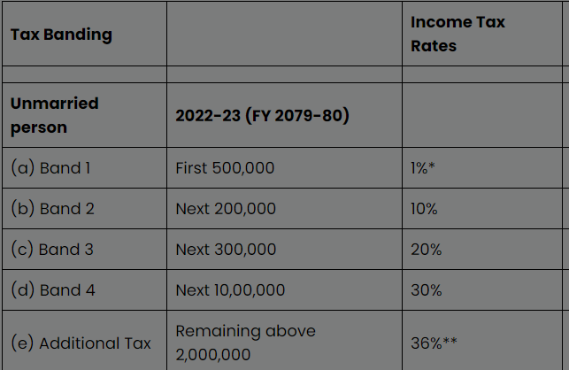
Updated Income Tax rates in Nepal for 2081/2082 (Corporate, Individual and Couple)

Slide 17
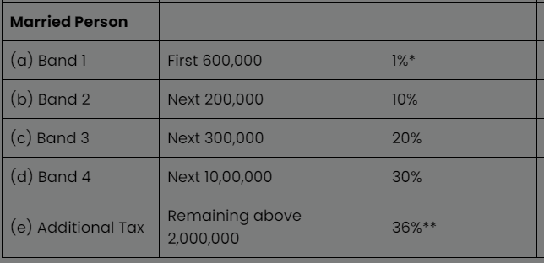
For Couple

Slide 18
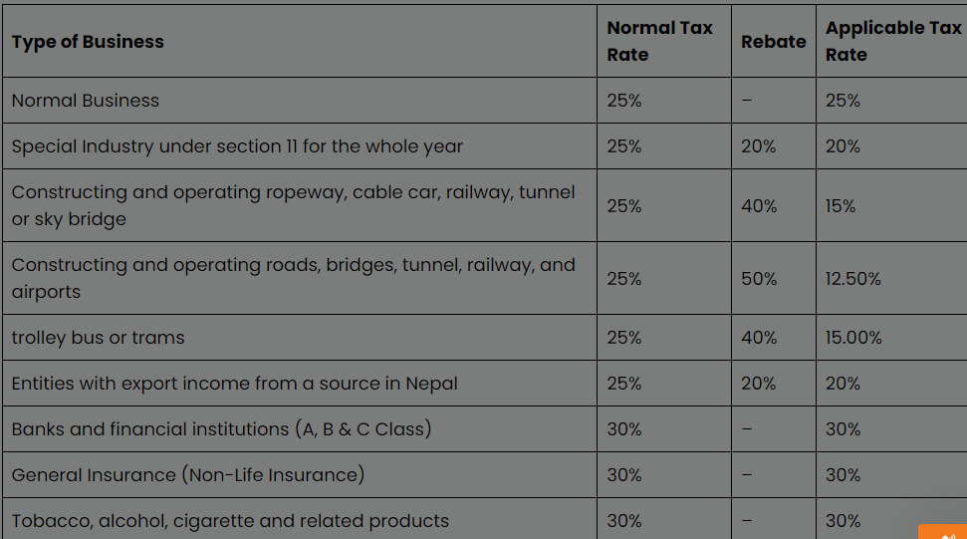
Corporate Tax Rate in Nepal

Slide 19
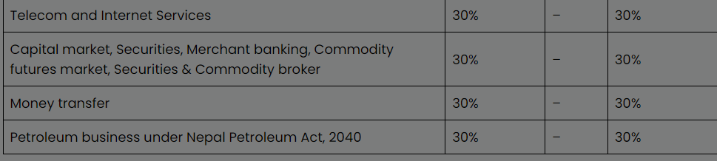

Slide 20
Depreciation rate to be charged on fixed assets under diminishing balance method
Furniture 25%
Building 10%
Machinery and equipment 15%

Slide 21
Cash Flow After Tax CFAT
Calculate CFAT of the following project. Use straight line depreciation method.
Initial investment Rs 100000
Net annual revenue Rs 20000
Life of the project 10 years
Salvage value Rs 10000
Tax rate 40%

Slide 22
Solution , Calculation table for CFAT
Year | Cash flow | Dep | Taxable amount | Tax rate @40% | Net revenue after tax | CFAT (add back depreciation )
0 | -100000 | - | - |  |  | -100000
1 | 20000 | 9000 | 11000 | 4400 | 15600 | 24600
2 | 20000 | 9000 | 11000 | 4400 | 15600 | 24600
3 | 20000 | 9000 | 11000 | 4400 | 15600 | 24600
4 | 20000 | 9000 | 11000 | 4400 | 15600 | 24600
5 | 20000 | 9000 | 11000 | 4400 | 15600 | 24600
6 | 20000 | 9000 | 11000 | 4400 | 15600 | 24600
7 | 20000 | 9000 | 11000 | 4400 | 15600 | 24600
8 | 20000 | 9000 | 11000 | 4400 | 15600 | 24600
9 10 | 20000 30000 | 9000 9000 | 11000 21000 | 4400 8400 | 15600 21600 | 24600 30900
Calculation table for CFAT

